Slide 1
RL’s Properties

Slide 2
Closure Properties of Regular Languages (Intersection)
Let L and M be languages over alphabet ∑. Then L ∩ M is the language that contains all strings that are in both L and M
Intersection of Regular Languages
  If L1 and L2 are regular languages then L1 ∩ L2 is also a regular language. i.e. Set of regular languages is closed under intersection

Slide 3
Closure Properties of Regular Languages (Intersection)
Proof
By Demorgan’s Law
L1 ∩ L2 = (L1’ U L2’)’
        = (L1’ + L2’)’
This implies that L1 ∩ L2 consists of all words that are not is either L1’ or L2’. As L1 and L2 are regular languages so are L1’ and L2’. There union L1’ + L2’ is also a regular language.

Slide 4
Closure Properties of Regular Languages (Intersection)
L1 = all strings with a double a
L2 = all strings with an even number of a’s
Both are regular languages and they have following RE respectively
R1 = (a+b)*aa(a+b)*
R2 = b*(ab*ab*)*
Both languages are regular, Kleen’s Theorem says that they can also be defined by FAs
a
a,b
b
a
b
b
a
-
+
-
+
b
FA1
a
FA2

Slide 5
Closure Properties of Regular Languages (Intersection)
Complements of FAs
a
a,b
b
a
b
b
a
x1-
+
+
x3
y1-
y2+
b
FA1’
a
FA2’
Join the machines to get FA3 = FA1’ + FA2’ which defines the language (L1’ + L2’)
Reverse the final status of each state of FA3 to get (FA1’+FA2’)’ that defines L1 ∩ L2
Apply the TG to RE conversion over FA3 to get r3 that defines the intersection of both languages

Slide 6
Closure Properties of Regular Languages (Intersection)
Second Method of Intersection
a
a,b
b
a
b
b
a
x1-
x2
x3+
y1-
+
y2
b
FA1
a
FA2
Join both the machines to get FA3 = FA1+FA2 that defines L1+L2
FA3 consists of states of both FA1 and FA2. Remove all the + and put a + only at a state where the corresponding x and y components both are final

Slide 7
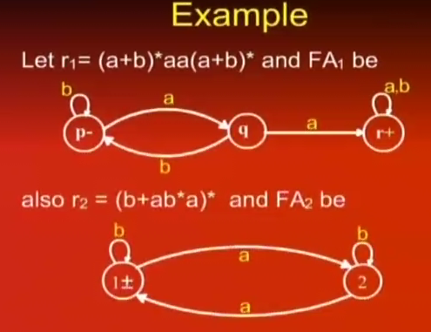

Slide 8
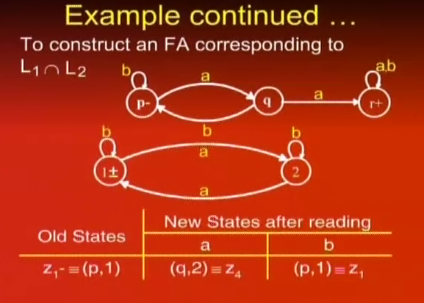

Slide 9
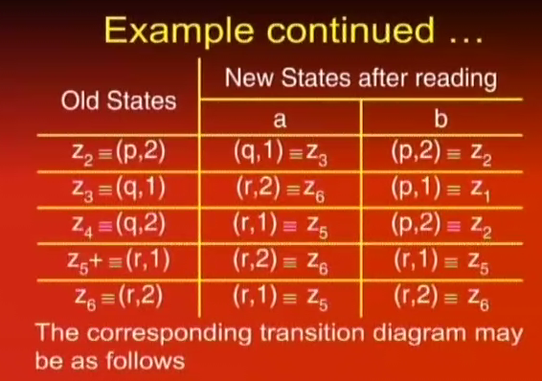

Slide 10
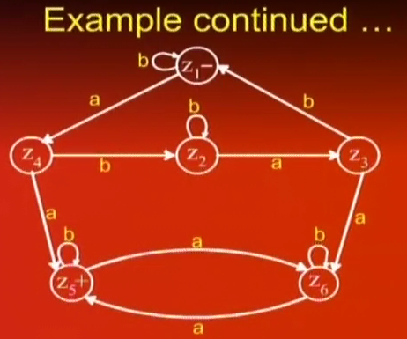

Slide 11
Closure Properties of Regular Languages (Closure)
If L is a regular expression then L* consists of all strings formed by the concatenation of arbitrarily many factors of L
Closure Property
  If L is a regular language so is L*

Slide 12
Closure Properties of Regular Languages (Closure)
Proof (By regular expression)
If a regular lanugage L is defined by a regular expression r then the language L* can be defined by r*. Thus L* is a regular language

Slide 13
Closure Properties of Regular Languages (Closure)
Proof (By Machines)
-
Λ
TG1
Λ
+

Slide 14
Closure Properties of Regular Languages (Concatenation)
If L1 and L2 are two regular languages then L1L2 contains all words formed by concatenation of a word from L1 with a word from L2
Concatenation of Regular Languages
  If L1 and L2 are two regular languages then so is L1L2.

Slide 15
Closure Properties of Regular Languages (Concatenation/Product)
Proof (By Regular Expression)
If L1 and L2 are regular languages then there are two regular expressions r1 and r2 which define these respectively. The language L1L2 can be defined by r1r2 which is also a regular expression. Hence L1L2 is also a regular language.

Slide 16
Closure Properties of Regular Languages (Concatenation/Product)
Proof (By Machines)
Λ
-
1
2
+
TG1
TG2

Slide 17
Non regular Languages
A language that cannot be defined by a regular expression
L={^,ab,aabb,aaabbb,aaaabbbb,aaaaabbbbb,…}
L = {a^{n}b^{n} for n=0 1 2 3 4 5 …}
Or L = {a^{n}b^{n}}
L is a non regular language as it can not be defined by any RE

Slide 18
Pumping Lemma
Regular languages are defined by Regular expressions and accepted by DFA, NFA and TG.
Non regular languages need some powerful machines for their description
The pumping lemma is used to prove certain languages as non regular

Slide 19
Pumping Lemma
“Let L be any regular language that has infinitely many words. Then there exist some three strings x, y and z (where y is not null) such that all the strings of the form xy^{n}z for n =1,2 ,… are words in L”

Slide 20
Pumping Lemma
Proof
If L is a regular Language then there is an FA that accepts exactly the words in L.
Let w be some word in L that has more letters in it than there are states in the FA.
When this string is executed on FA , the path it traces cannot visit a new state for each letter of the string because there are more letters than states.
Therefore, it must at some point revisit a state that has already been visited.

Slide 21
Pumping Lemma
The word w can be broken into three parts
  X: Consisting of all letters of w starting at the beginning that lead up to the first state that is revisited. X can be null if the path for w revisits the start state as its first revisit
  Y: It starts at the letter after the substring x. It denotes the substring of w that travels around the circuit coming back to the same state the circuit began with. Because there must be a circuit hence y cannot be null even if it loops around just once
  Z: This is the rest of the string of w after substring y. It can be null. It may also loop around the y-circuit or any other

Slide 22
Pumping Lemma
Thus w = xyz and w is accepted by this machine
Path for xyyz

Slide 23
Pumping Lemma
Example
a
b
b
1-
2+
3
a
a
b
b
a
a,b
4
5
a
6+
b
W = bbbababa, bbbabbababa

Slide 24
Pumping Lemma
Application
Let L = {a^{n}b^{n} for n=0,1,2,3, ….}
Breakdown into three components xyz
Y as sequence of a’s (xyyz)
Y as all b’s (xyyz)
Y as combination of a’s and b’s (xyyz)
Is L Regular?

Slide 25
Pumping Lemma (Version 2)
If L is an infinite language accepted by an FA with N states. Then for all words w in L that have more than N letters, there are string x, y and z where y is not null and length(x)+length(y) does not exceed N such that w = xyz and all string of the form xy^{n}z are in L
Application on PRIME

Slide 26
Myhill-Nerode Theorem
The pumping Lemma established the nonregularity of a language through contradictions.
Myhill-Nerode Theorem proves a language to be regular or not by constructive algorithm
Societies of states for certain classes of strings

Slide 27
Myhill-Nerode Theorem
“Given a language L, any two strings x and y are in the same class if for all possible strings z whether both xz and yz are in L or both are not
  The language L divides the set of all possible strings into separate (mutually exclusive) classes
  If L is regular, the number of classes L creates is finite
  If the number of classes L creates is finite, then L is regular

Slide 28
Myhill-Nerode Theorem
Proof of Part 1
  Is S is in a class with X and S is also in a class with Y, then X and Y must be in the same class
Proof of Part 2
b
1
a
a
a,b
₋
+
b
b
a
2

Slide 29
Myhill-Nerode Theorem
Proof of Part 3
Given the finite classes of L create an FA
If a class contains a word of L then all the strings in the class are words in L
Example: Language of all words that end in a
C1 = all strings that end in a, the final state
C2 = all strings that do not end in a, the start state
a
b
a
C₂-
C₁+
b

Slide 30
Decidability of Regular Languages
Decidability is concerned with three issues
  Is the language described empty (Emptiness)
  Do two descriptions of a language actually describe the same language (Equivalence)
  Language defined by an FA has finitely or infinitely many words in it

Slide 31
Decidability of Regular Languages (Emptiness)
Checking Emptiness (Formal Method through FA)
  Paint the start state blue
  From every blue state, follow edge that leads out of it and paint the destination state blue, then delete this edge from the machine
  Repeat above step until no new state is painted blue
  When the procedure has stopped , if any of the final states are painted blue, then the machine accepts some words and if not it does not

Slide 32
Decidability of Regular Languages (Equivalence)
Checking Equivalence of Regular languages
  Given two regular languages L₁ and L₂ defined by either of RE or FA
  Build FA for L₁’ and L₂’
  Create FAs for L₁ ∩ L₂’ and L₂ ∩ L₁’
  Build automaton for (L₁ ∩ L₂’)+(L₂ ∩ L₁’)
  This machine accepts the language of all words that are in L₁ but not in L₂ or else in L₂ but not in L₁.
  If L₁ and L₂ are the same language, this machine cannot accept any words. If this machine accepts a single word even the Λ then L₁ is not equal to L₂

Slide 33
Decidability of Regular Languages (Equivalence)
Equivalence
a,b
a
a,b
a
p1+-
b
p2
q1-
b
q2+
FA1
FA1’
a,b
a,b
r1+-
b
r2
s1-
b
s2+
a
a
a
b
a
b
r3+
s3
FA2
FA2’

Slide 34
Decidability of Regular Languages (Equivalence)
Equivalence of Regular Languages
  (L₁ ∩ L₂’) + (L₂ ∩ L₁’) = (L₁’ + L₂)’ + (L₂’ + L₁)’
p1 or s3
q1 or r1
p1 or s1
q1 or r3
a
a
-
a
-
a
a,b
a,b
b
b
b
b
p2 or s2
q2 or r2
(FA1’+FA2)’
(FA2’+FA1)’

Slide 35
Decidability of Regular Languages (Finiteness)
Finiteness (through Regular Expressions)
  Scan the RE and if it contains the closure operator “*” then the RE defines an infinite language
  What about
  Λ*, (Λ+aΛ*)(Λ*+Λ)* and (Λ+aΛ)*(Λ*+Λ)*
  Only the second defines infinite language
  If language is being defined by an FA then it can be converted into an RE and verified for finiteness

